Slide 1
Montgomery County Redevelopment Commission Annual Meeting
November 10, 2020

Slide 2
Agenda
Welcome & Opening Remarks
Overview of Work Focus Areas:
Thoroughfare Plan Update
Water Infrastructure Expansion Update
Wastewater Infrastructure Expansion Update
Residential Development Efforts
Site Development Efforts
Current TIF Budget & Impact on Taxing Districts
Q&A

Slide 3
Consultants – Full Time
Jim Peck – County Engineer
HWC Engineering
Full-Service Design Firm
Planning
BCS Management
Project Management
Peters Municipal Consulting
Financial Management
CRMorphew Consulting
Business Attraction Guidance
Taylor, Chadd, Minnette, Schneider & Clutter
Ongoing Legal and General Advice

Slide 4
Collaboration / Specific Issues
Ice Miller LLP
Legal Advice regarding Bonds and Ban Resolutions

Slide 5
Overview of Work Focus Areas

Slide 6
Thoroughfare Plan Update
Jim Peck, County Engineer

Slide 8
Water Infrastructure Expansion Project Update
John Frey, VP-RDC

Slide 9
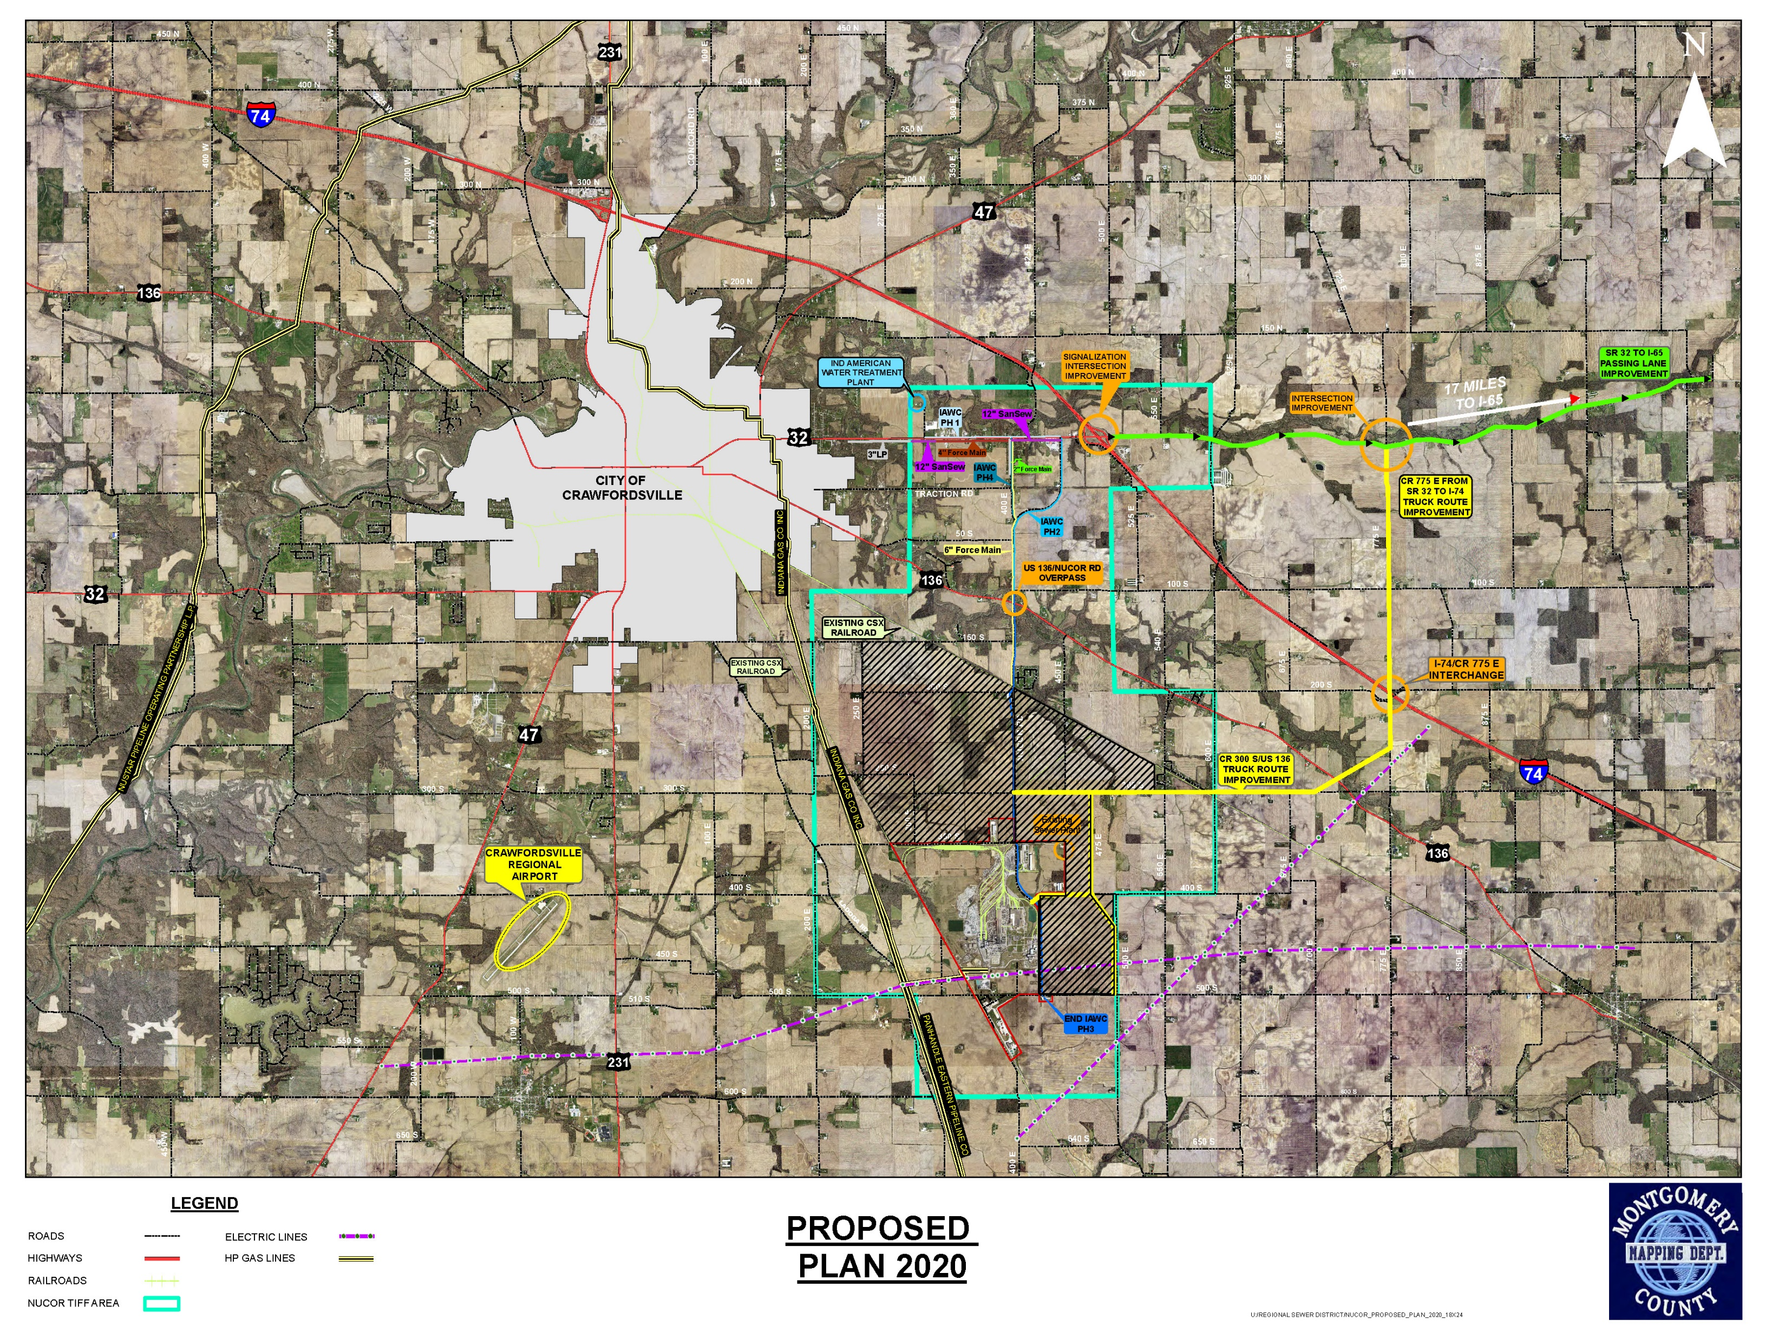

Slide 10
Wastewater Infrastructure Expansion Project Update
Lana Beregszazi,
BCS Management

Slide 11
Wastewater Infrastructure Project To-Date
Montgomery County Regional Sewer District provides sanitary sewer service to the RDC TIF and economic development area
Installation of 2 regional lift stations along SR 32
Collection System expansion - northward on Nucor Road to SR 32, westerly on SR 32
Installation of a total of 29,800 linear feet of sewer main
Installation of a total of 15,500 linear feet of sewer lateral
Decommissioning of 52 existing septic systems in Chigger Hollow addition

Slide 12
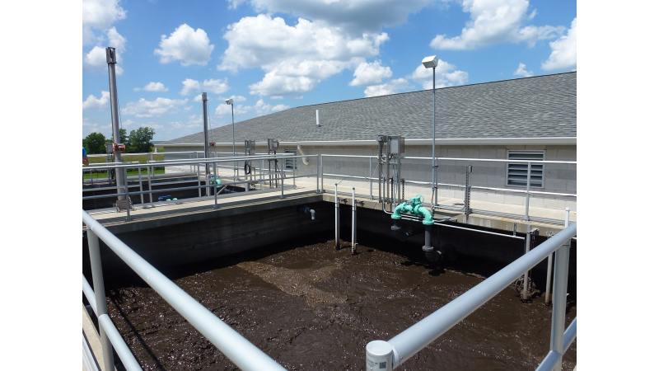

Slide 13
Current Infrastructure Expansion Projects
The Regional Sewer District’s treatment plant is operating near 50% of its 100,000 gallons per day operational capacity
Many industrial users are high-volume wastewater generators
A phased capacity expansion has been initiated in preparation for economic development activity
Phase 1 – Design to 600k GPD capacity
Phase 2 – Build to 300k - 600k GPD capacity depending on user needs
Phase 3 – Plant design allows for expansion up to 1.2 million gallons per day

Slide 14
Residential Development Efforts
Ron Dickerson & John Frey

Slide 15
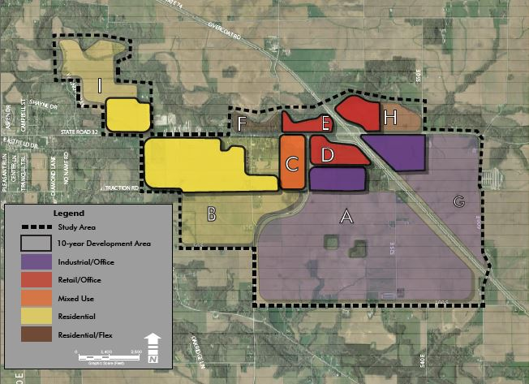
10- Year Conceptual Development

Slide 16
Site Development Efforts
Grant Schouweiler,
BCS Management

Slide 17
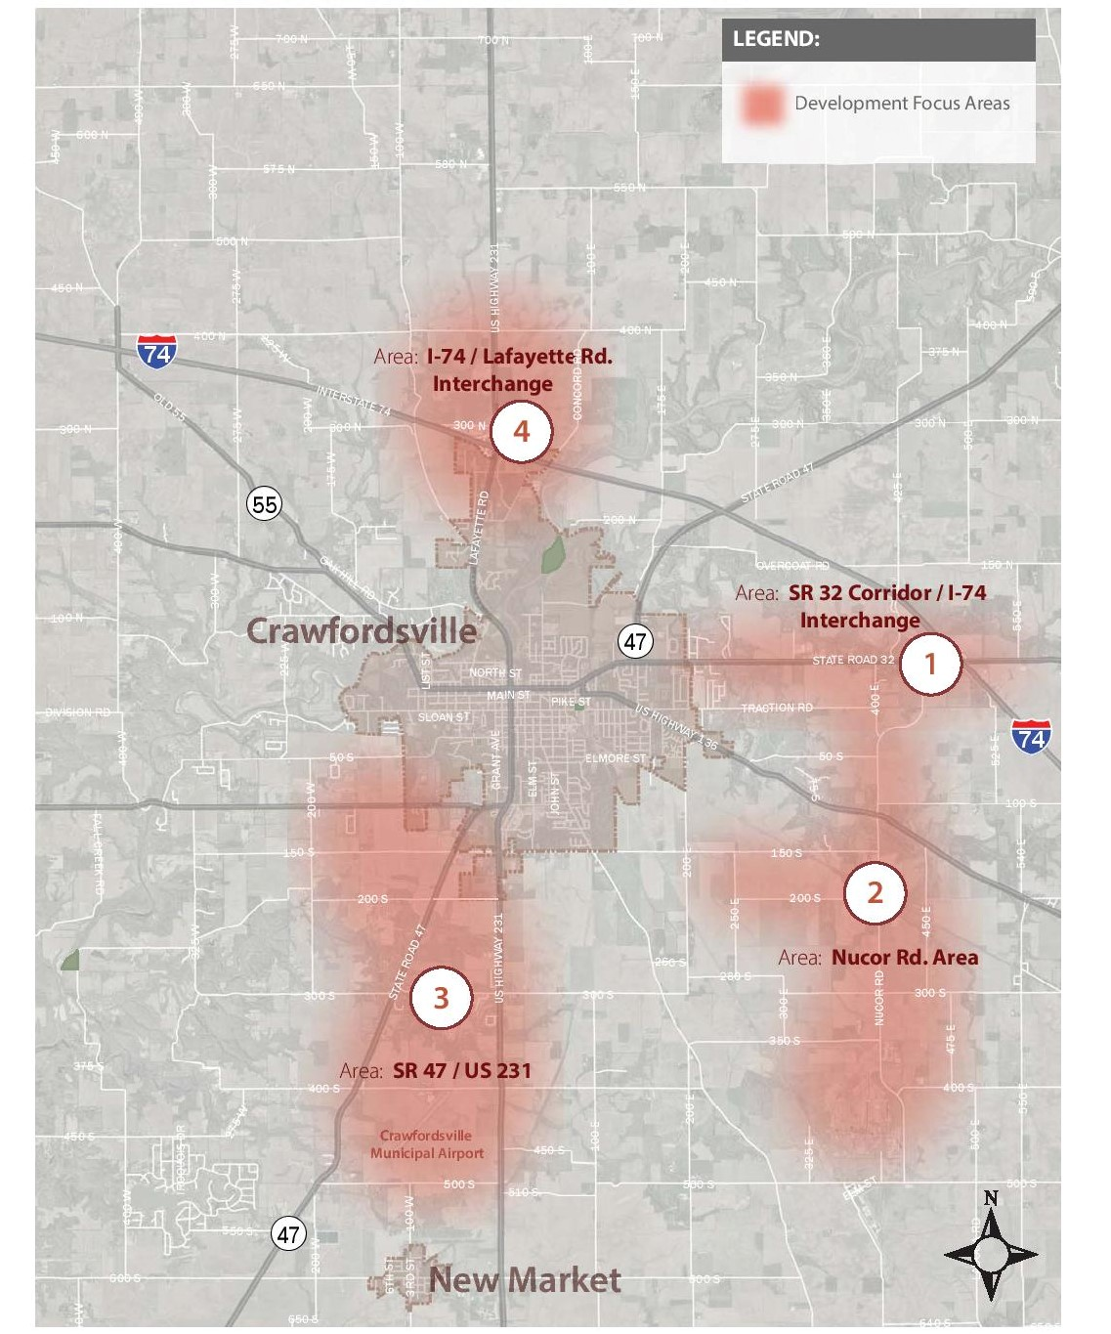

Slide 18
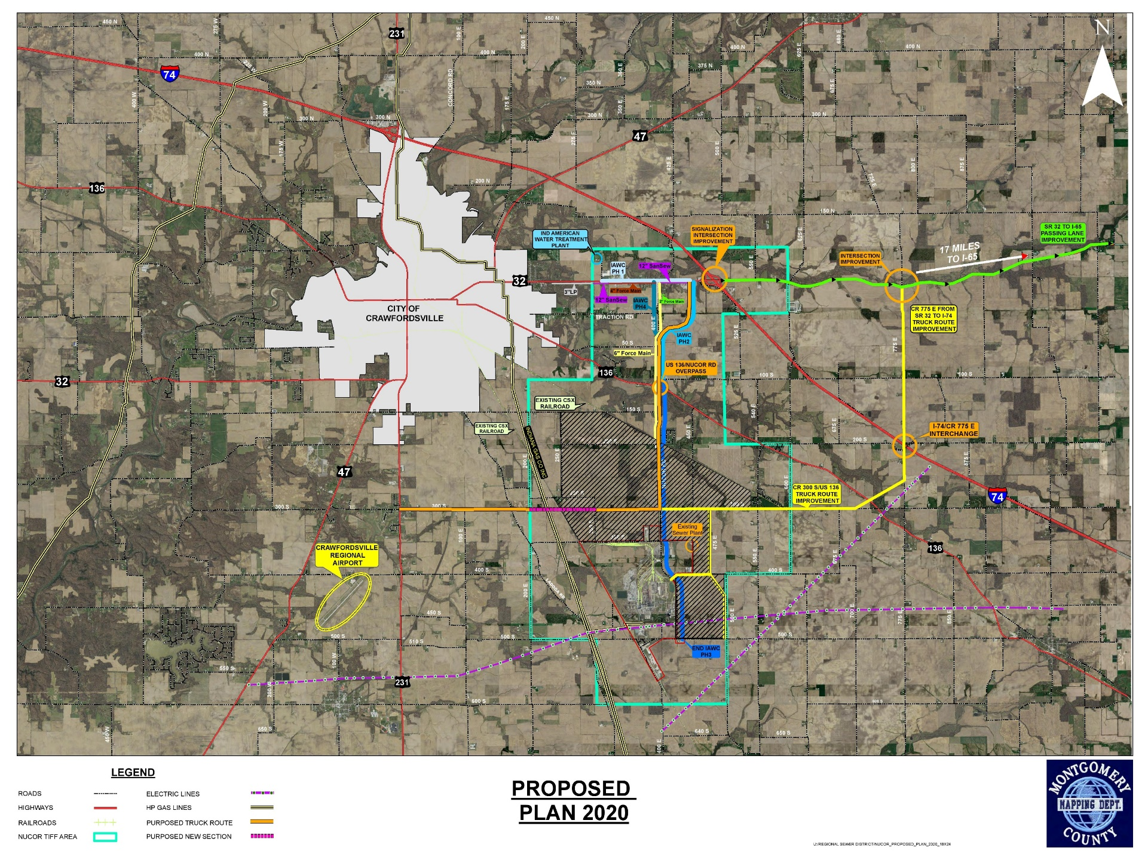

Slide 19
Nucor TIF Parcel Inventory
Landowner dynamics varied
Multi-generation family farms
Investors
Multiple landowners open to offers but unwilling to name their price
Fear of underselling
Would rather wait to receive an offer to initiate negotiation
Not listing on the market

Slide 20
Firms Reached

Slide 21
Marketing & Development Partner
Working on behalf of the RDC
Assessing Property Values
Incorporate Developer’s Prospective
Detailed Development Plan
Marketing Strategy to Reach Interested Buyers
BCS Management is currently working with the RDC’s Review Committee to finalize an agreement with a marketing & development partner

Slide 22
Current TIF Budget & Impact on Taxing Districts
Jeff Peters, Peters Municipal Consultants

Slide 23
2020 Montgomery County
Redevelopment Commission
Annual Presentation
IC 36-7-25-8: Each redevelopment commission shall annually present information for the governing bodies of all taxing units that have territory within an allocation area of the redevelopment commission. The presentation shall be made at a meeting of the redevelopment commission and must include the following: (1) The commission's budget with respect to allocated property tax proceeds. (2) The long-term plans for the allocation area. (3) The impact on each taxing unit.

Slide 24
Summary
The commission’s budget can be seen on Page 2 and consumes most of the allocated property tax proceeds anticipated through 2023. The budget includes consulting services for engineering, legal, financial, marketing, debt service on bonds and notes, and any other consulting which assists the RDC in fulfilling its functions and plans. The 2021 budget is $1,525,000.
The long-term plans for the allocation area include providing incentives and infrastructure needed to attract investment to fully develop the allocation area. The commission has undertaken funding to establish and expand sewer service and to expand water service. Some of the debt service funding this infrastructure is scheduled to continue throughout the life of the allocation area. As additional development and tax increment revenue occur, new infrastructure investment, such as sewer plant expansion, is expected in order to perpetuate further development.

Slide 25
Summary
The impact on each taxing unit, and the calculation thereof, is
shown on Pages 3 – 5. In summary the tax and circuit breaker impact and its comparison to revenue follow.

Slide 31
Comments & Notes
The RDC maintains a current budget document which quarterly looks at the current year budget to actual and also extends through 2023. The largest expenditures in the budget are debt service on the bonds and notes outstanding. The future budgets also include debt service payments. The payments for the sewer extension project include principal and interest which is scheduled to continue through the life of the allocation area.

Slide 32
Comments & Notes
The extension of the sewer collection system may necessitate an expansion of the sewage treatment plant which may require the expenditure of cash reserves and or another bond issuance with repayment throughout the remaining life of the allocation area. The water extension project was funded through a Bond Anticipation Note or BAN in which interest only is scheduled to be paid during the first 5 years and then either long term bonds will be issued, or the Note will be paid off with cash on hand.

Slide 33
Comments & Notes
The current plan is to pay off the BAN with accumulated cash in 2022. A BAN allows for interest only payments in the beginning which utilizes a smaller commitment of the revenue stream and therefore allows the funding of project(s) prior to the full development of the incremental AV which is supported by the project(s). As the revenue stream increases, appropriate amounts would be expected to pay the remaining debt service on the project(s).

Slide 34
Comments & Notes
The projects previously undertaken by the RDC support various commercial properties which contribute to the funding of the RDC. For pay 2020, the RDC is expected to have ~$79,058,000 in assessed value designated as increment. The vast majority of that assessed value resides in taxing district 025 which impacts Montgomery County, Union Township, South Montgomery Schools and the Crawfordsville Library (see page 3).

Slide 35
Comments & Notes
If the TIF were to expire with the current pay 2020 incremental assessed value, then that assessed value would fall back to the tax base. That increase in assessed value to the tax base would reduce some property tax rates (see page 3) which would in turn lower circuit breaker impacts (see page 4) and drive up the net collection of property tax. Other property tax rates could remain the same as they are statutorily regulated by rate and if those rates remained at their current levels, then tax revenue would increase (see page 5). Pages 3 – 5 show our estimated impacts of the incremental AV returning to the tax base.

Slide 36
Questions & Wrap-up
Ron Dickerson

